Slide 1
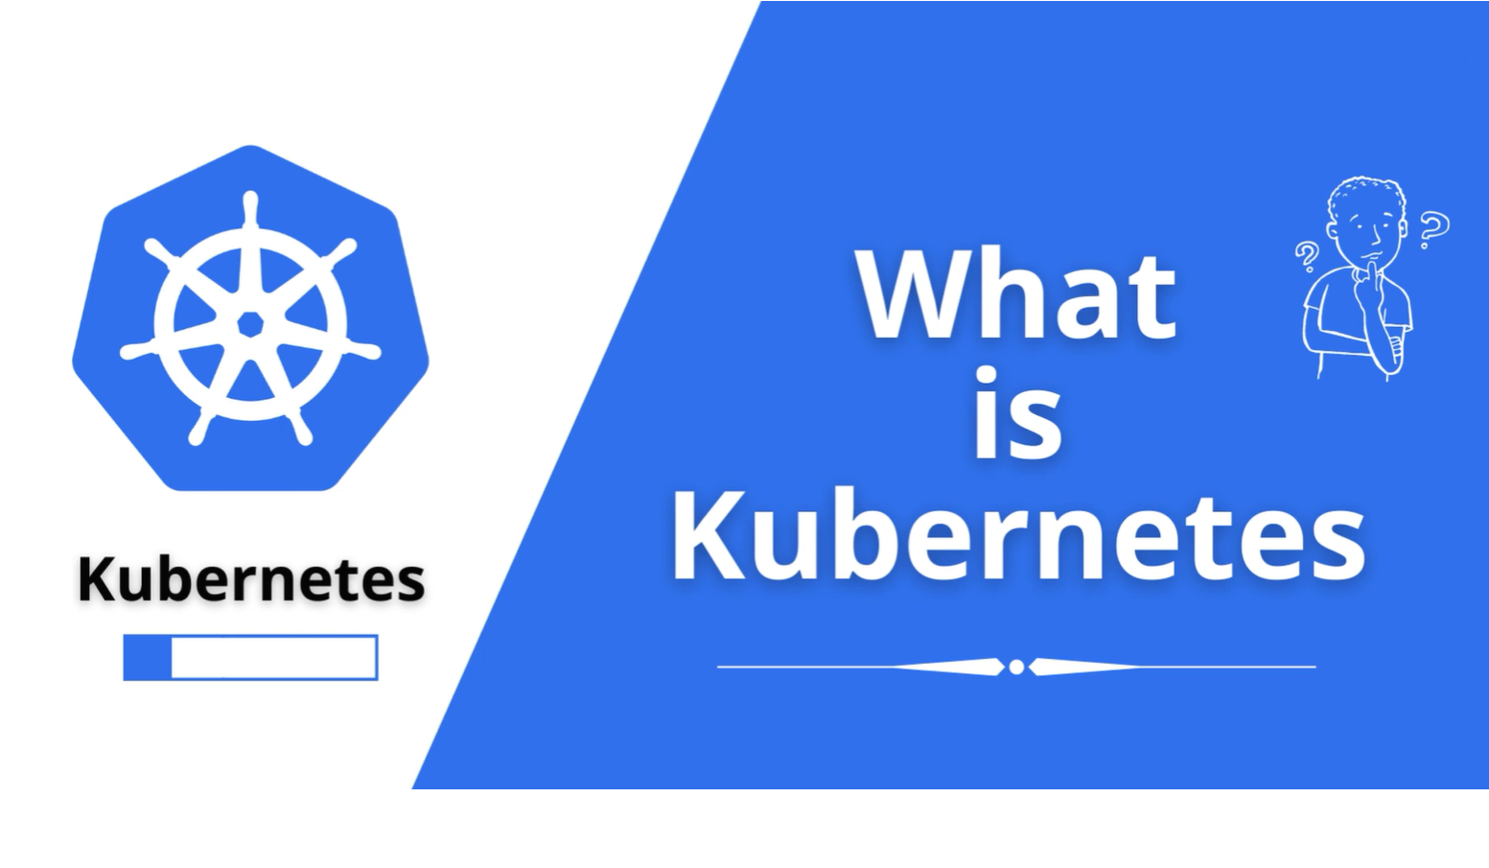

Slide 2
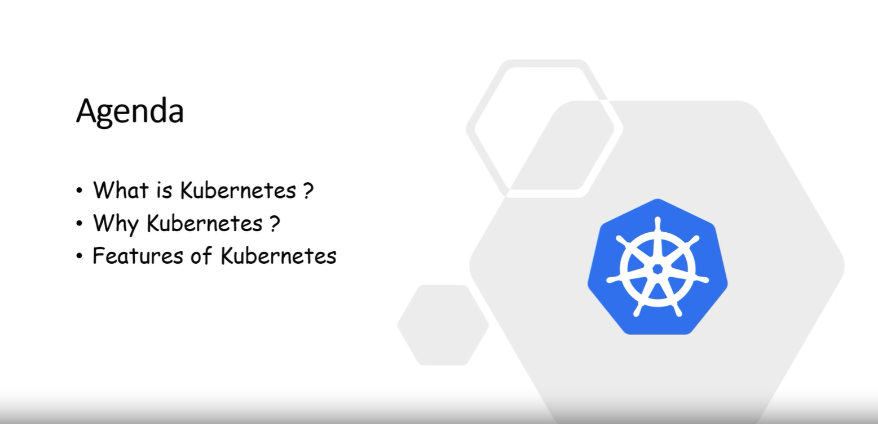

Slide 3


Slide 4
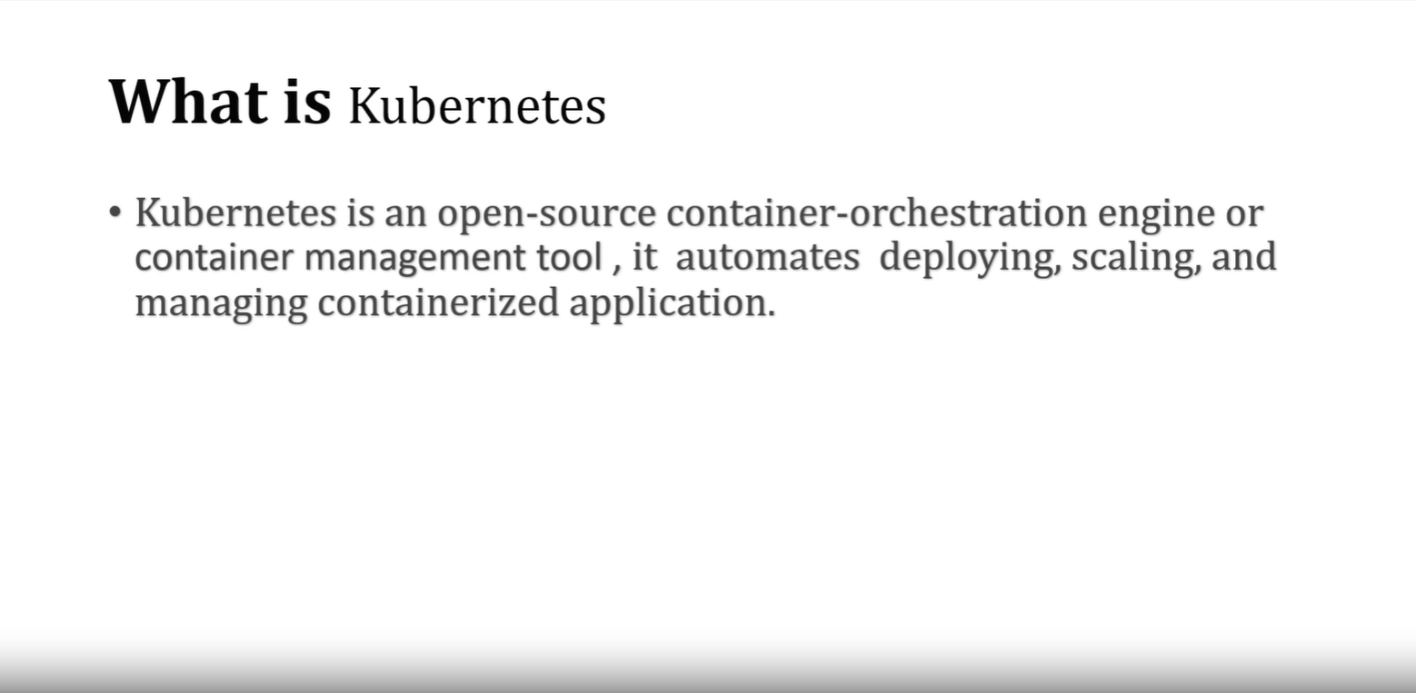

Slide 5
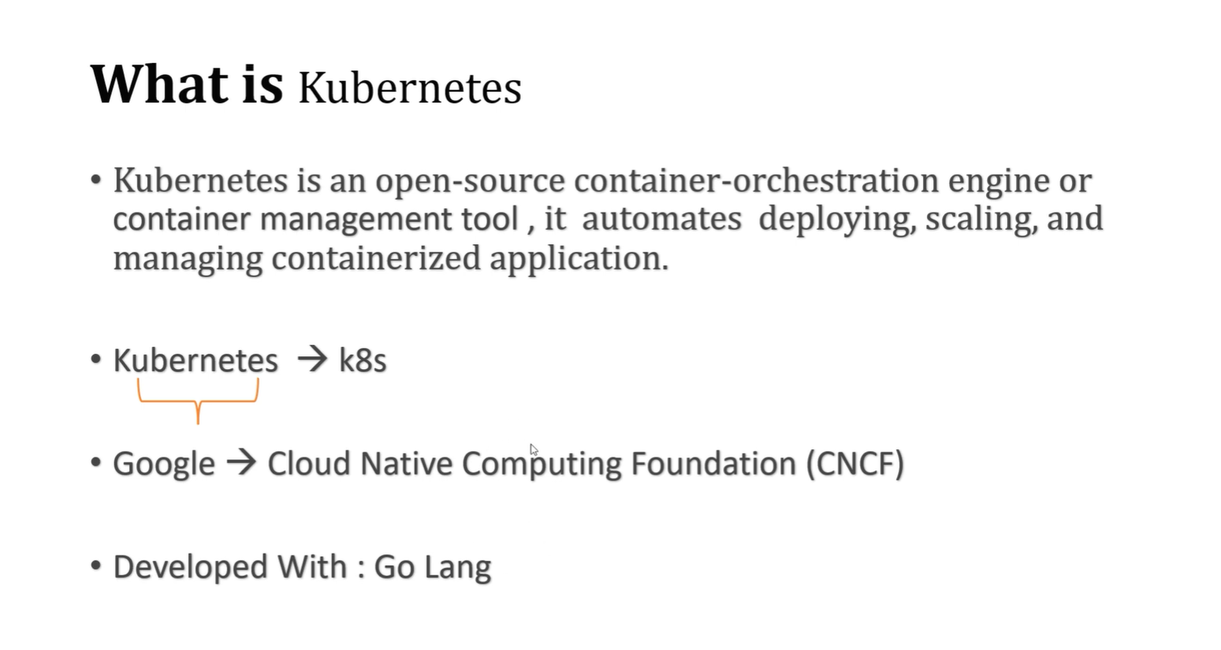

Slide 6
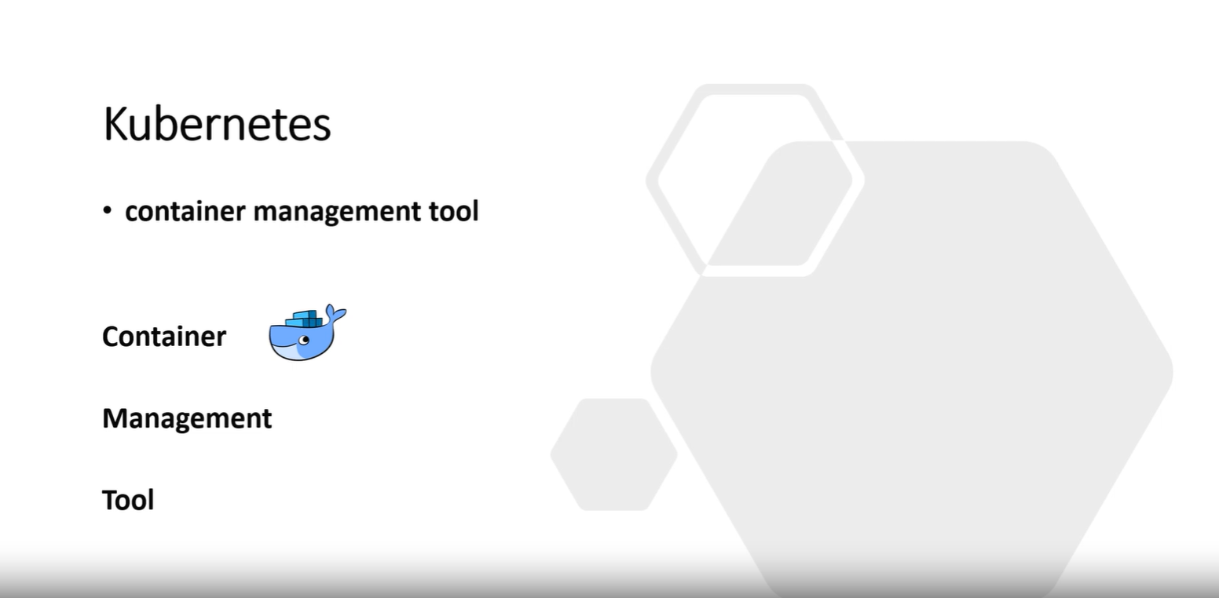

Slide 7
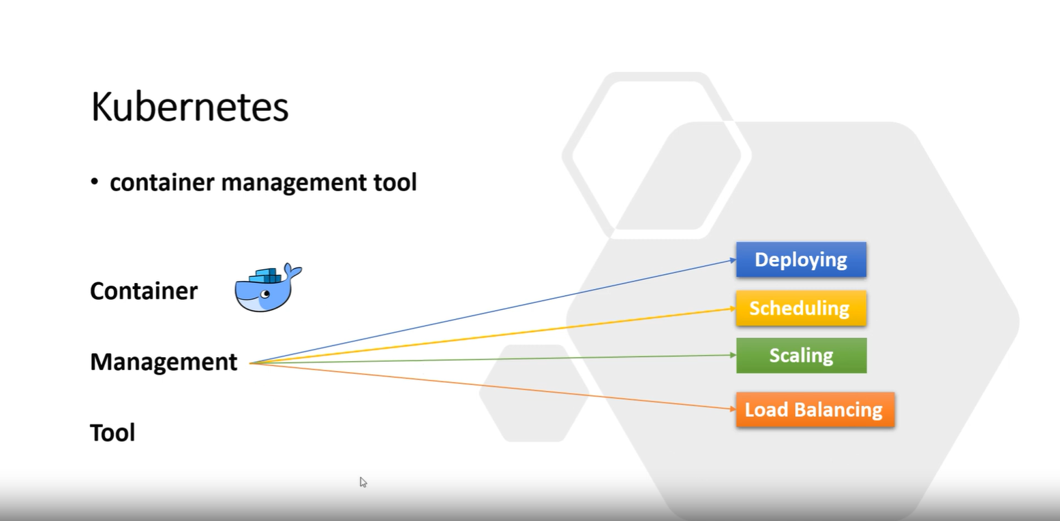

Slide 8
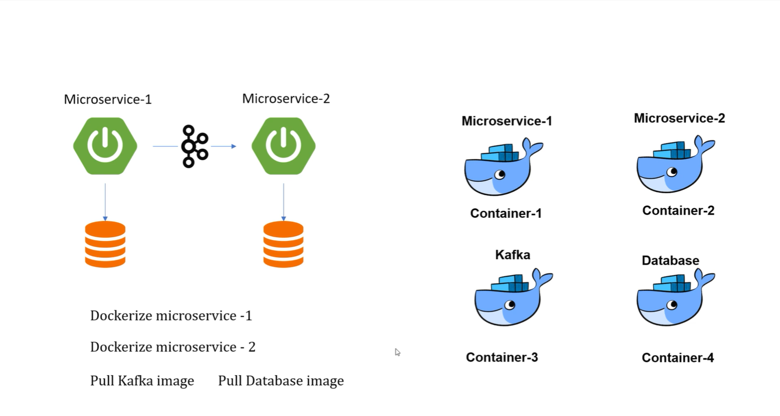

Slide 9
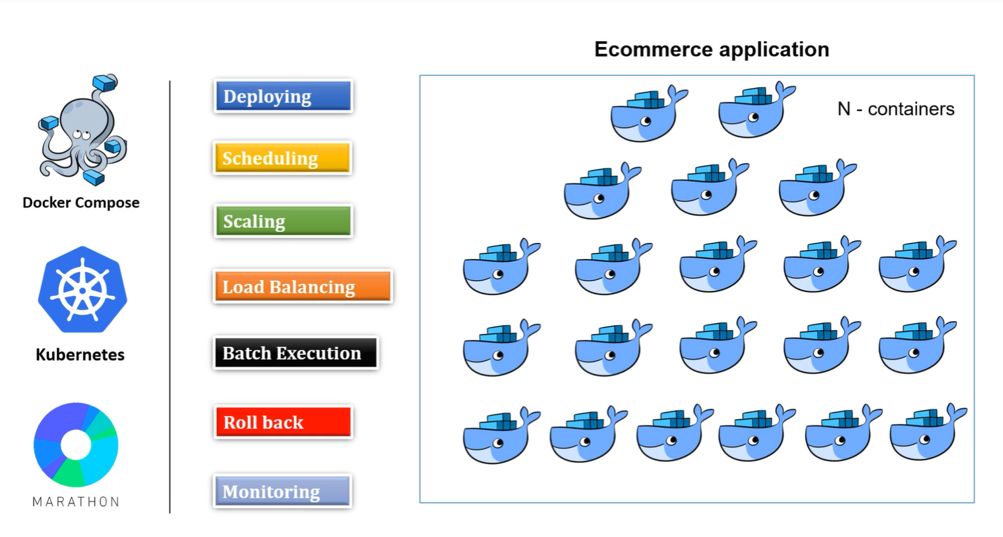

Slide 10
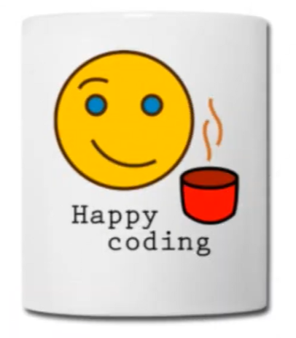
Part 1 ends here
THANKS FOR ATTENDING THE SESSION

Slide 11
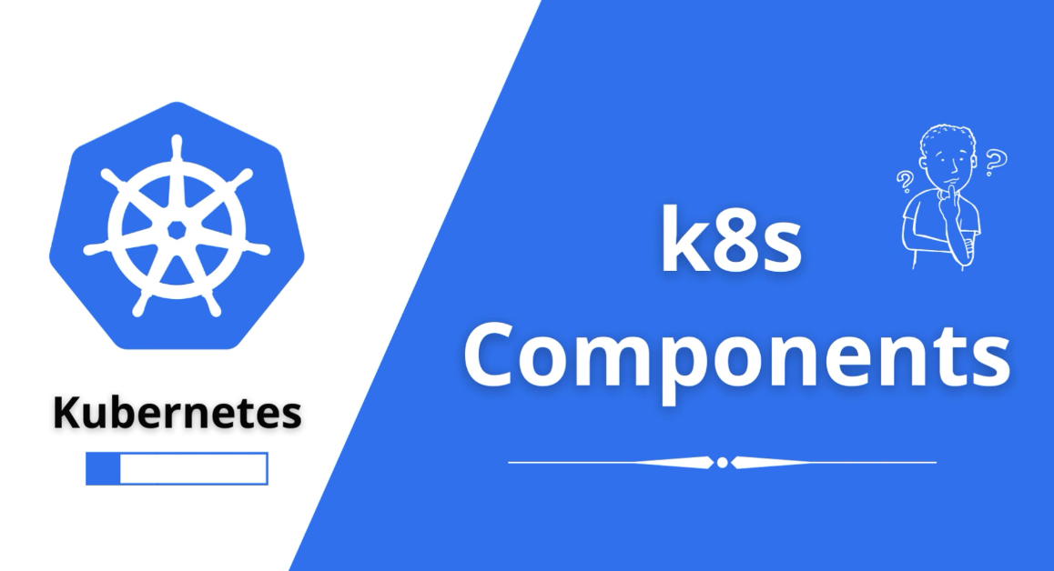

Slide 12
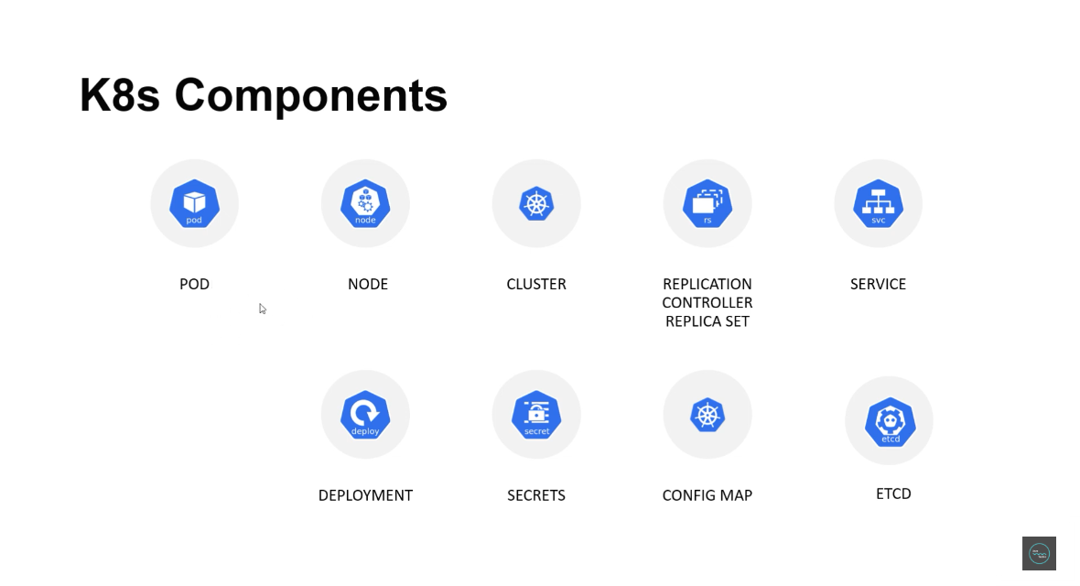

Slide 13
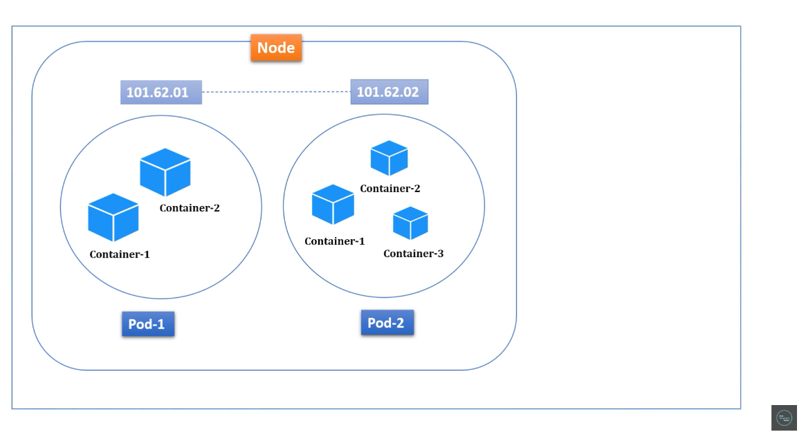

Slide 14
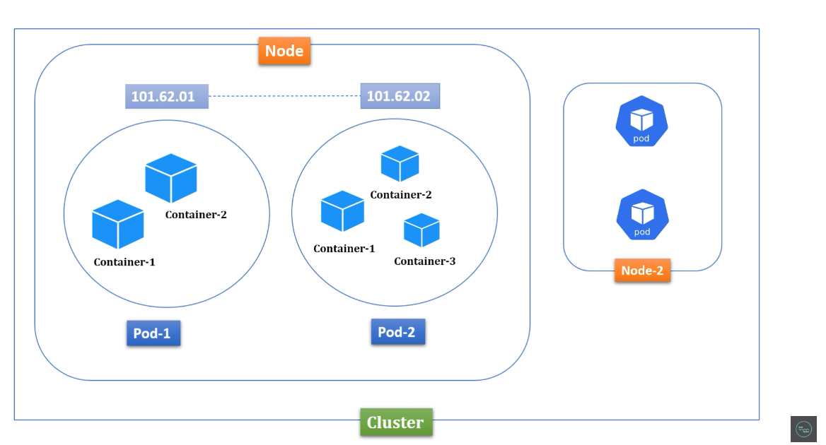

Slide 15
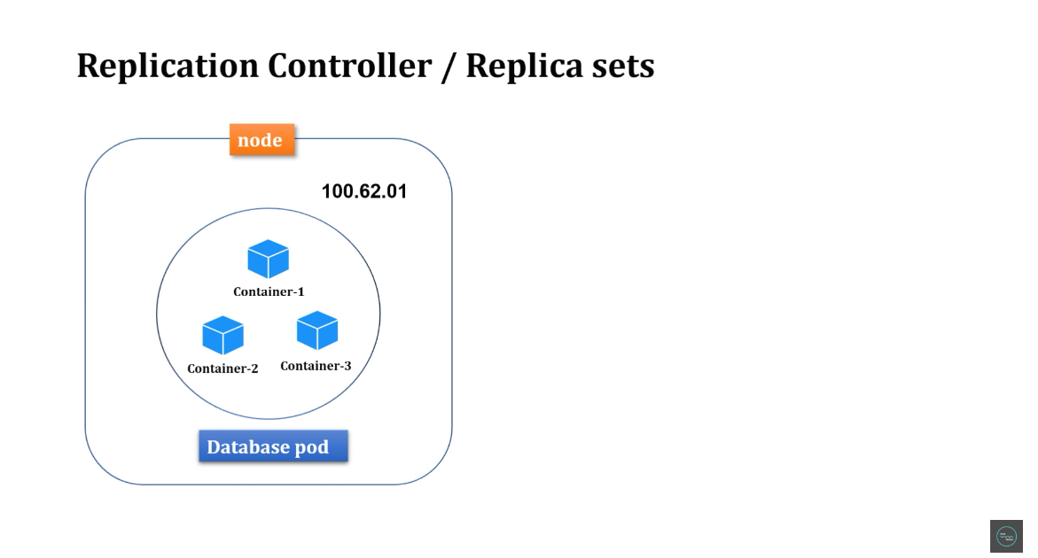

Slide 16
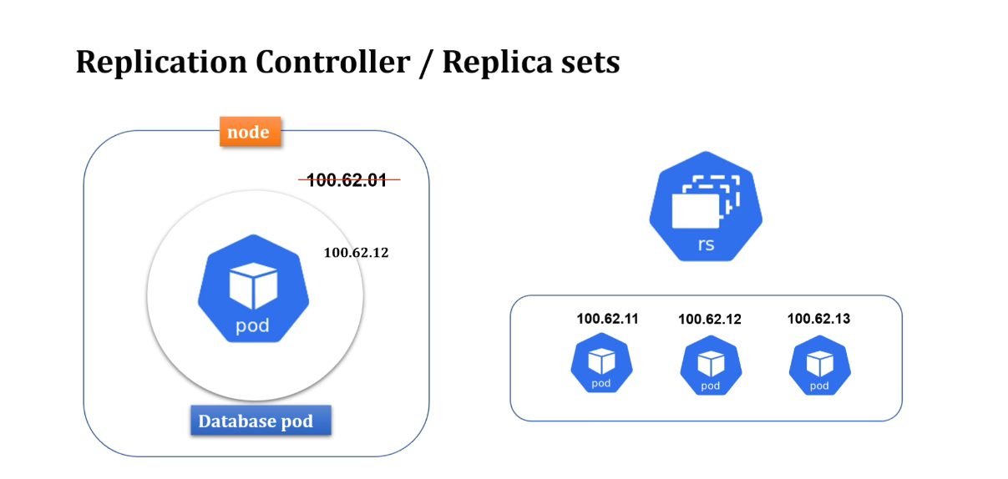

Slide 17
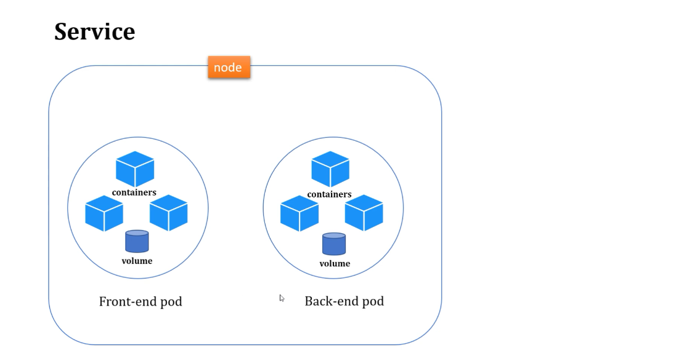

Slide 18
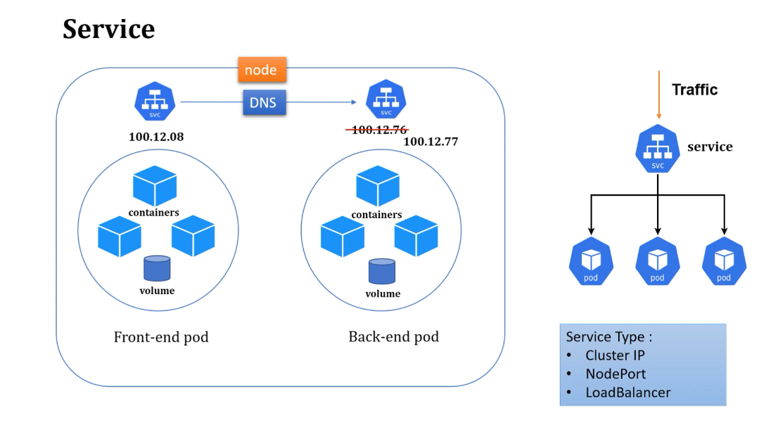

Slide 19
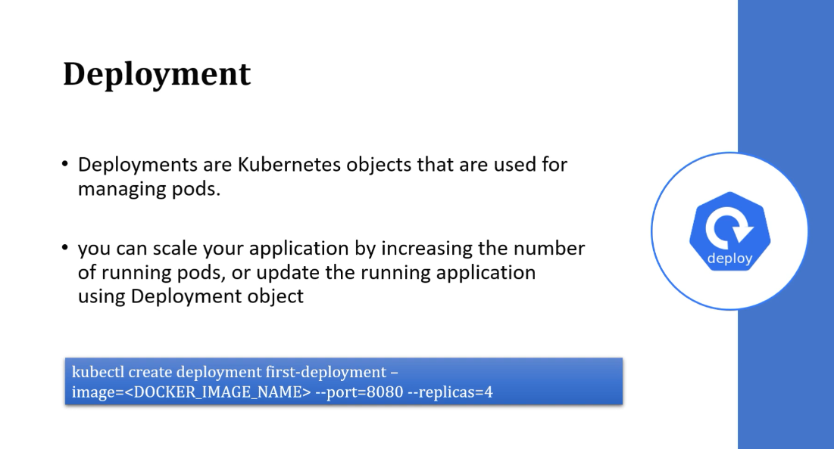

Slide 20
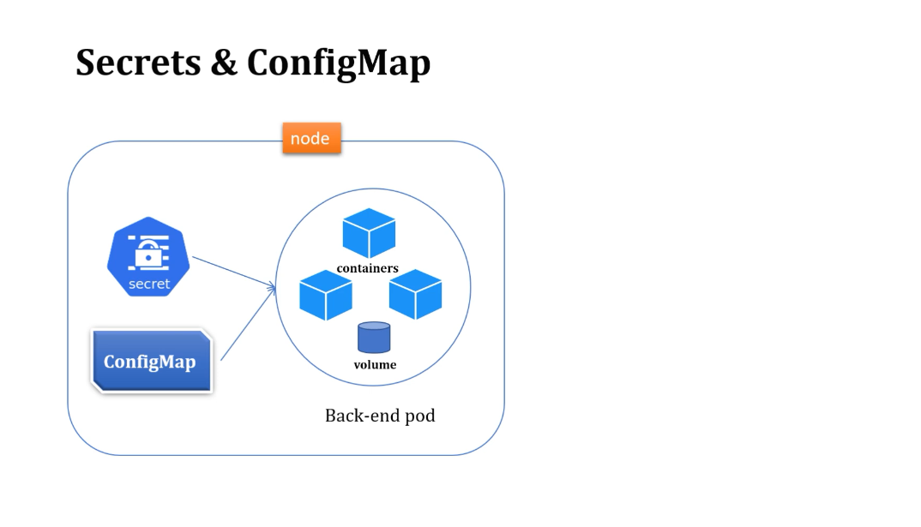

Slide 21
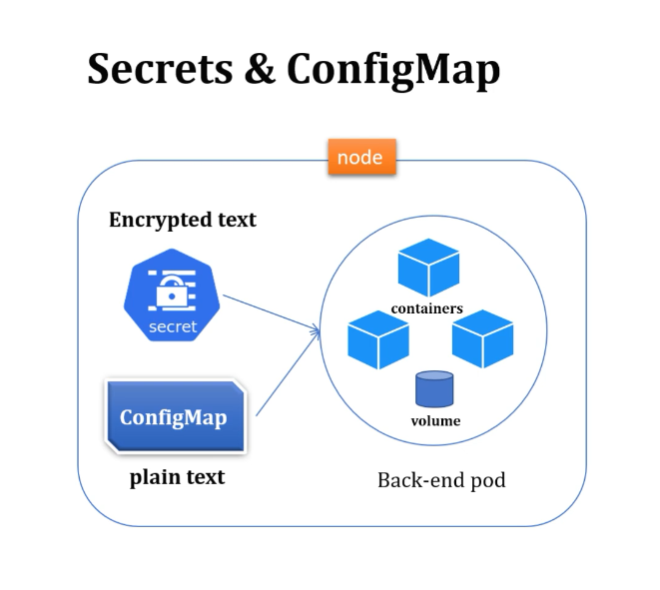

Slide 22
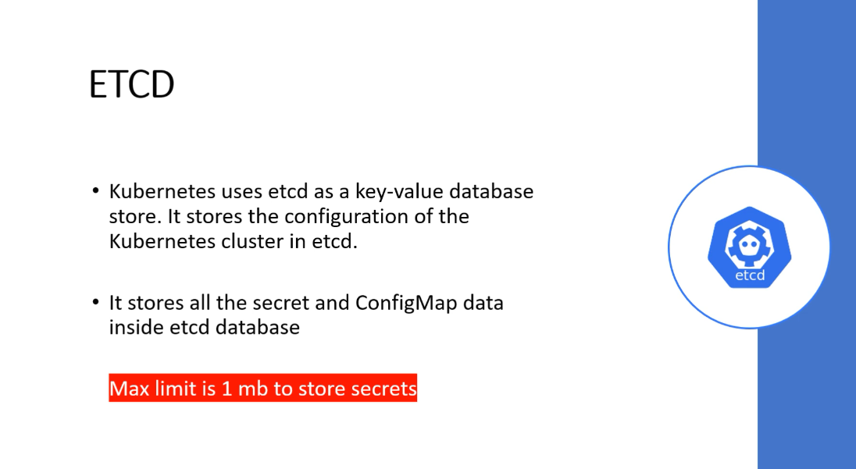

Slide 23
Part 2 ends here
THANKS FOR ATTENDING THE SESSION

Slide 24
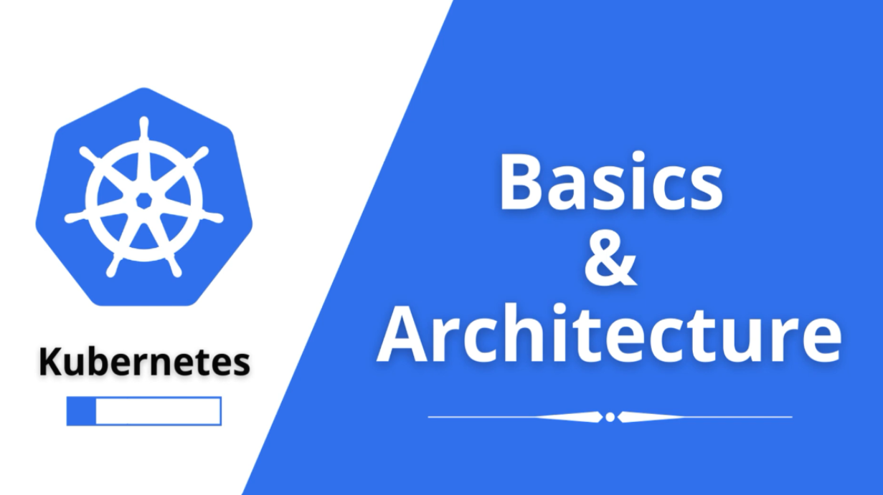

Slide 25
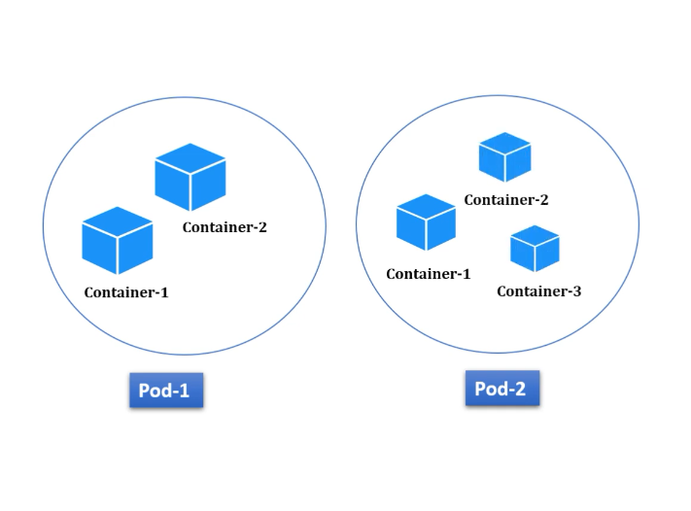

Slide 26
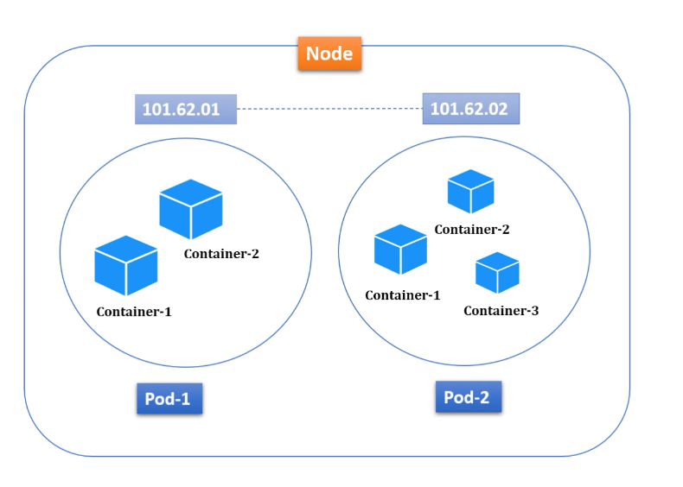

Slide 27
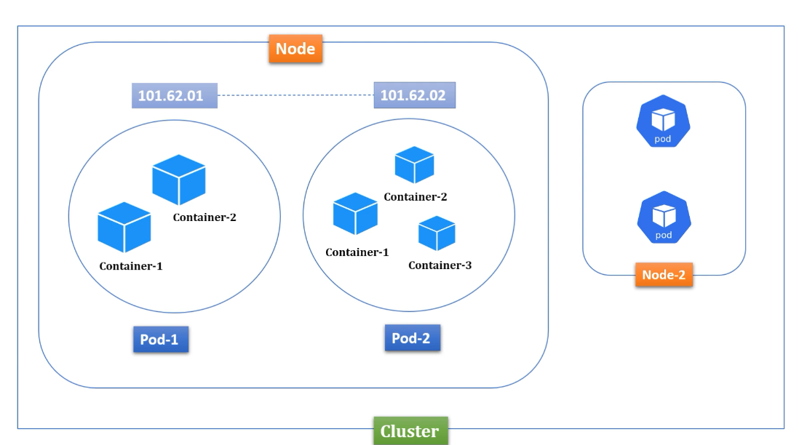

Slide 28
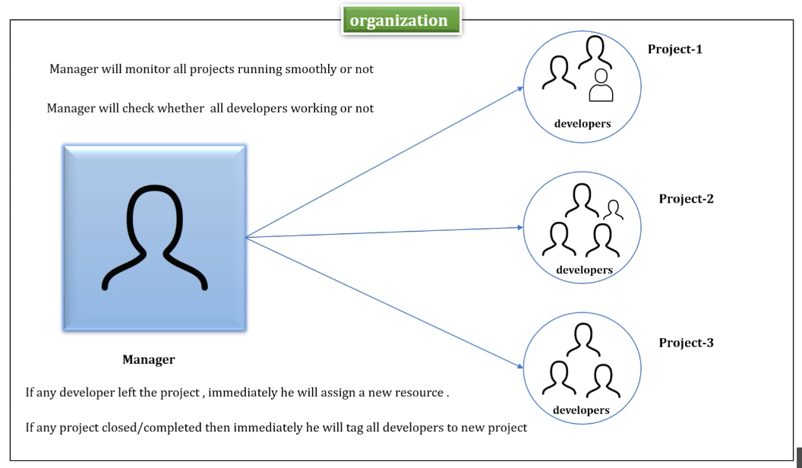

Slide 29
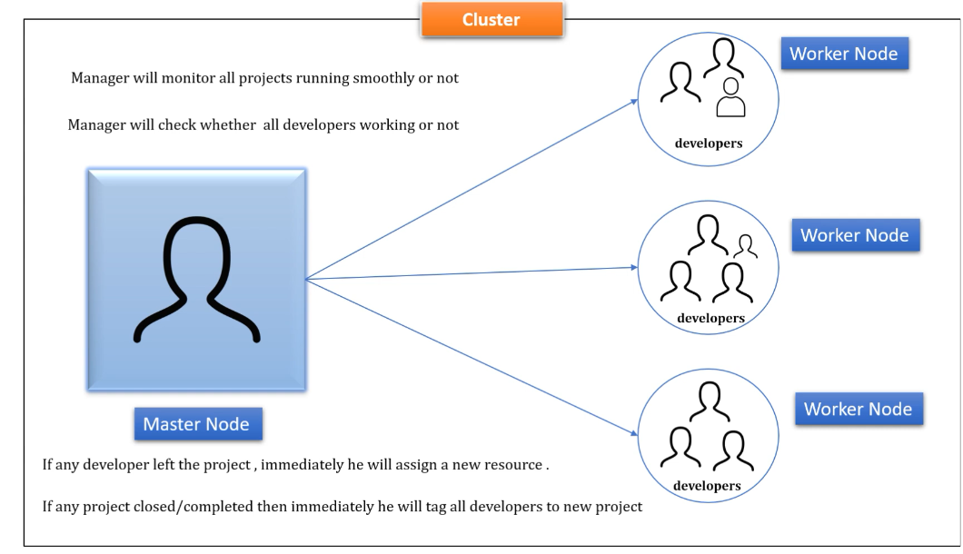

Slide 30
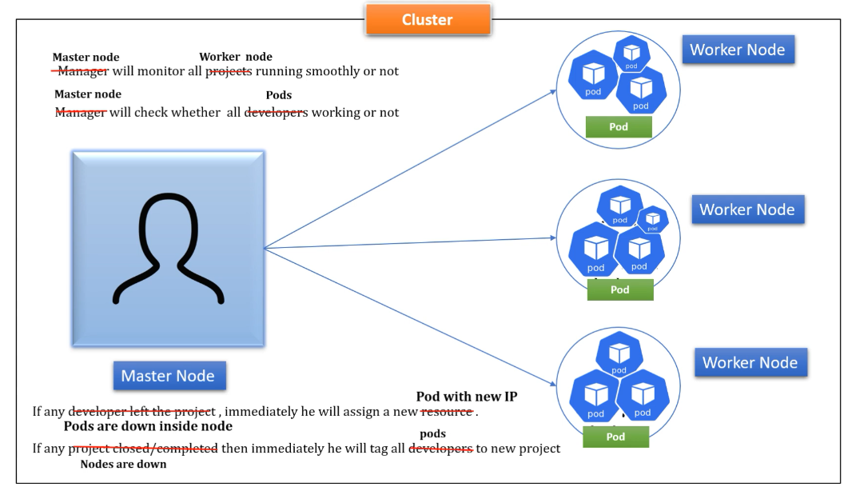

Slide 31
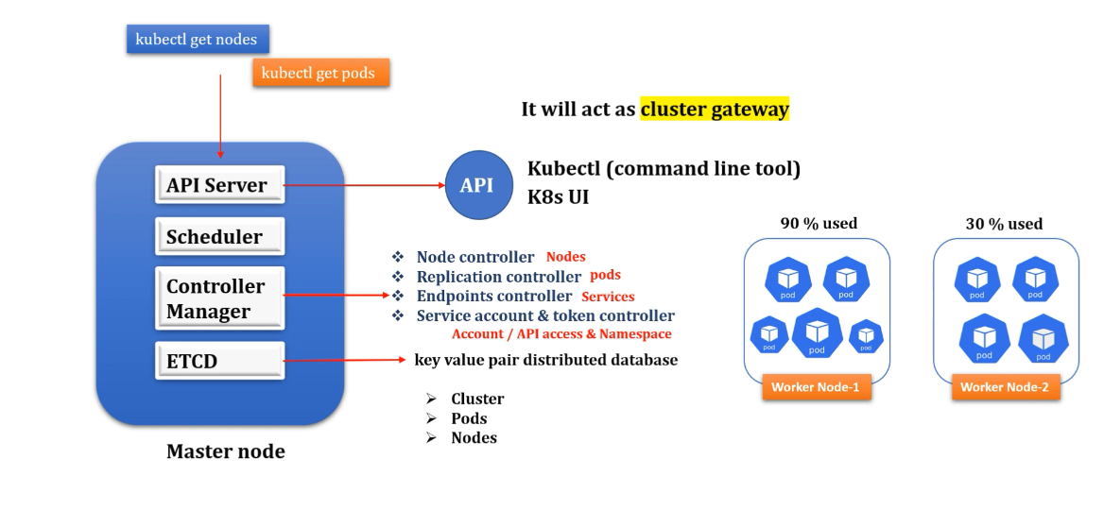

Slide 32
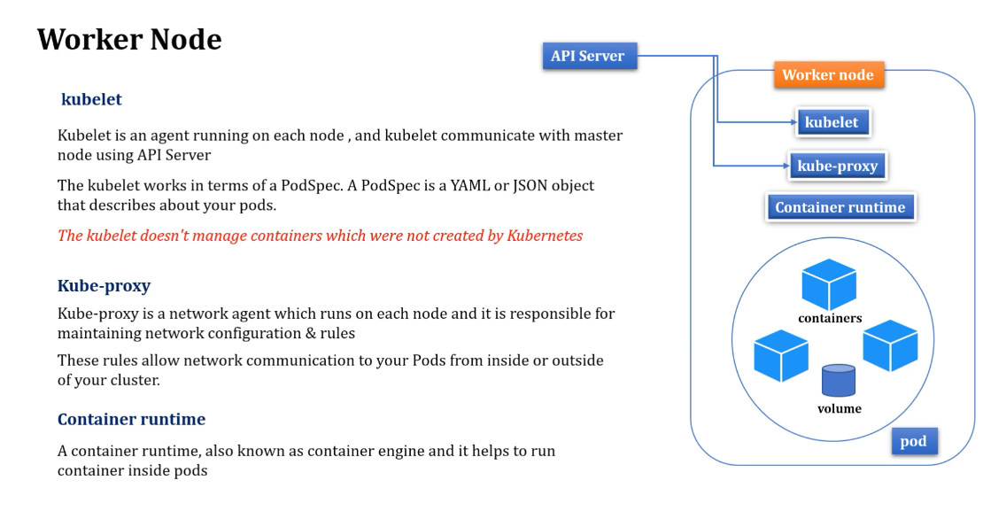

Slide 33
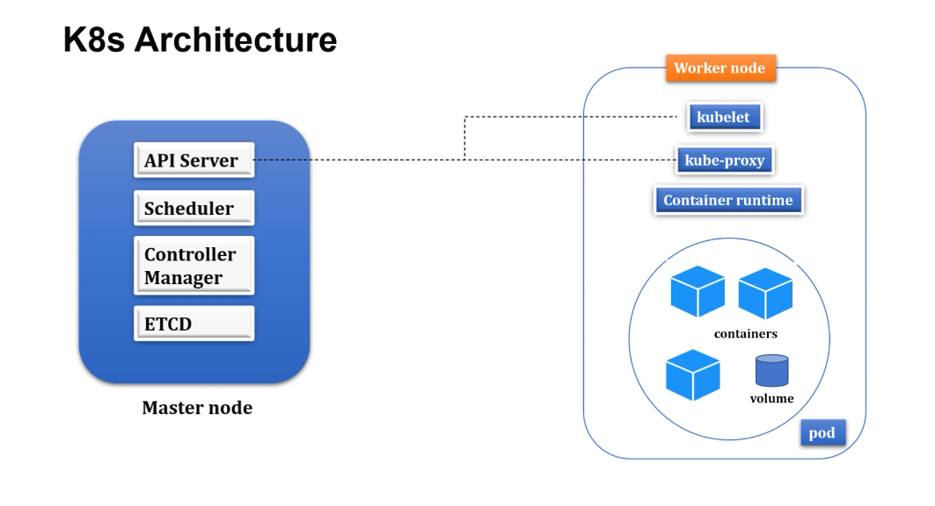

Slide 34
Part 3 ends here
THANKS FOR ATTENDING THE SESSION

Slide 35
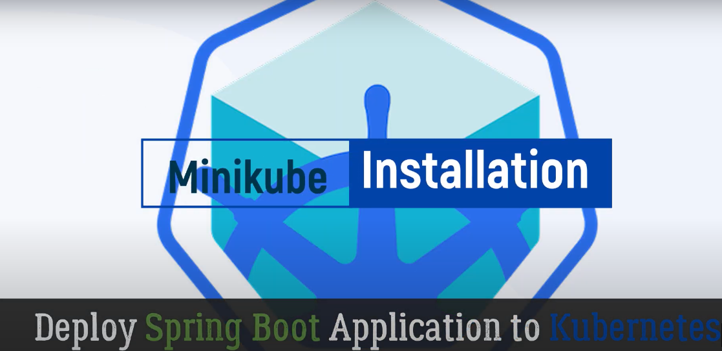

Slide 36
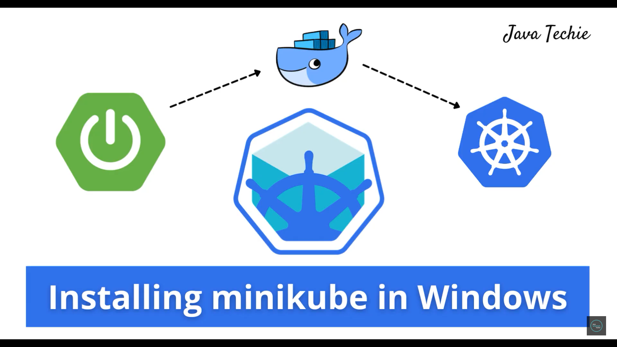


Slide 37
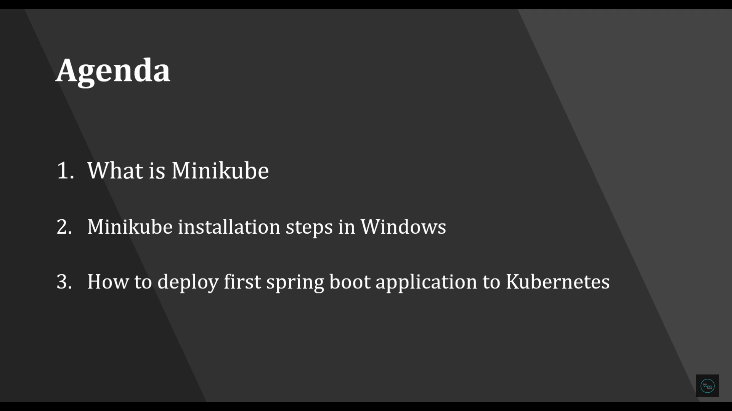


Slide 38
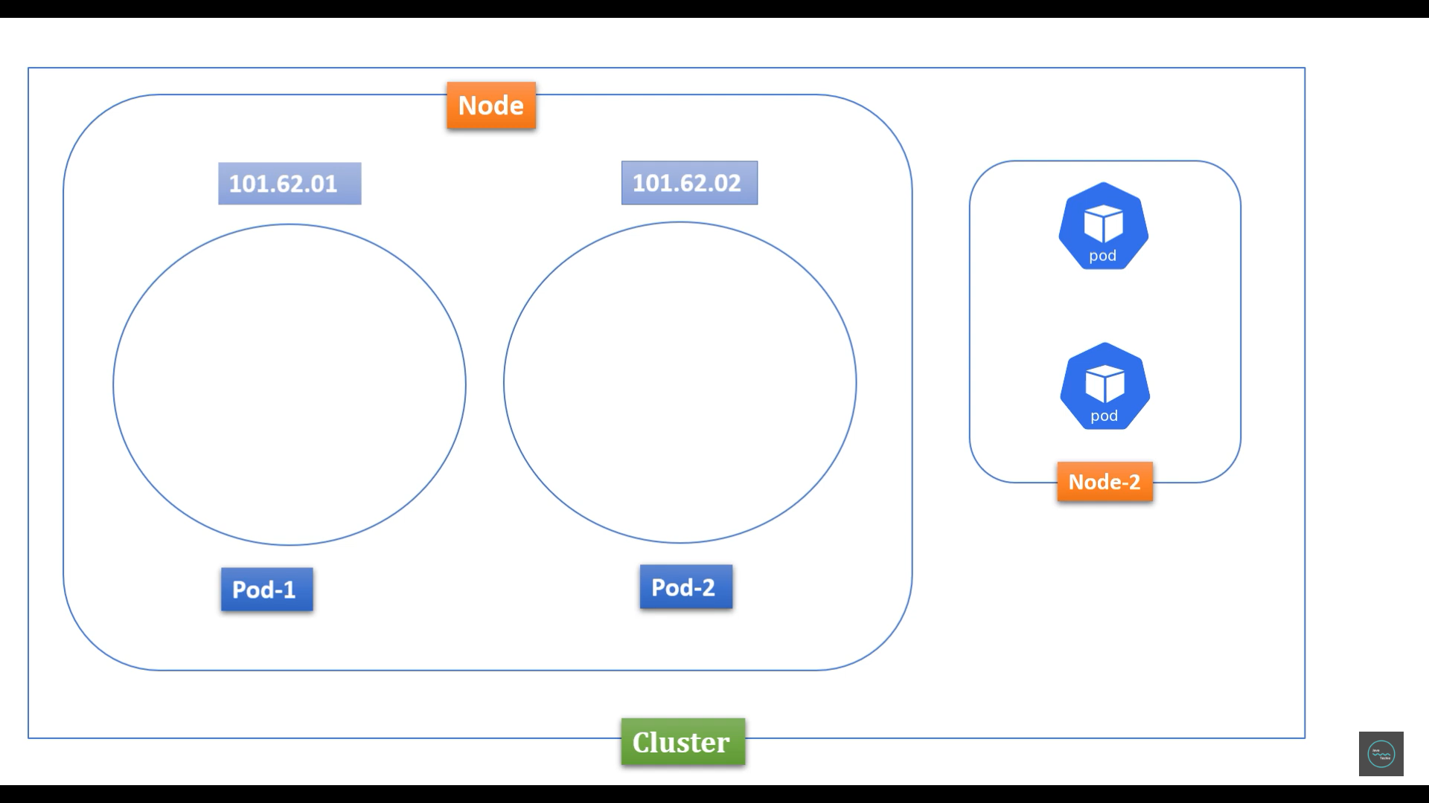


Slide 39
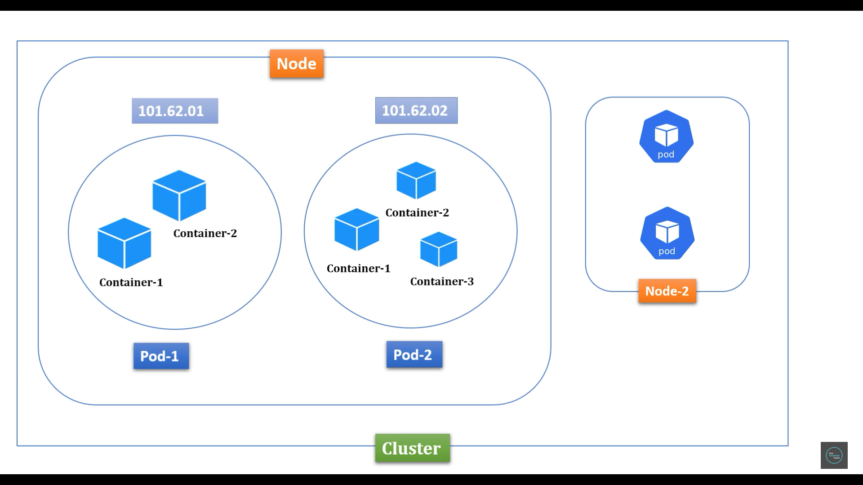

Slide 40
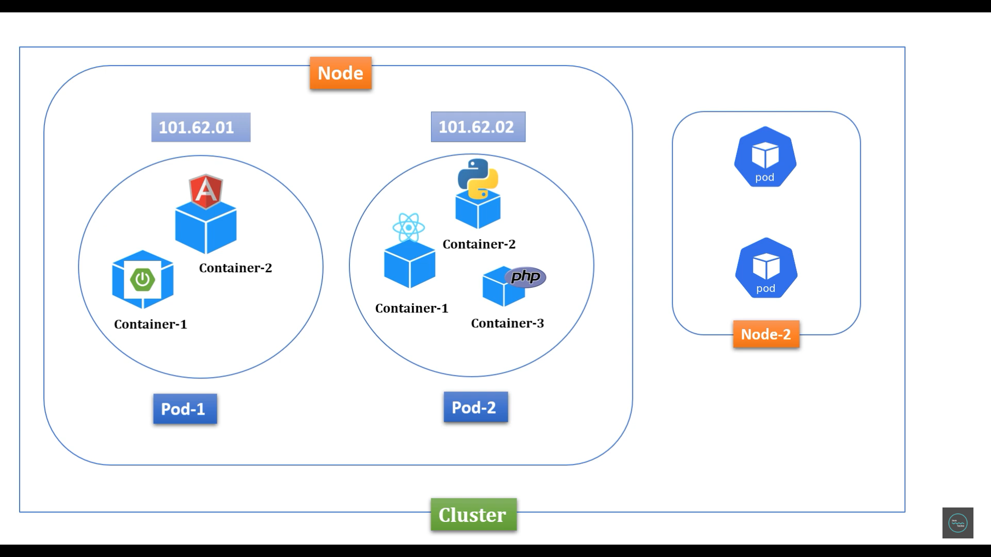

Slide 41
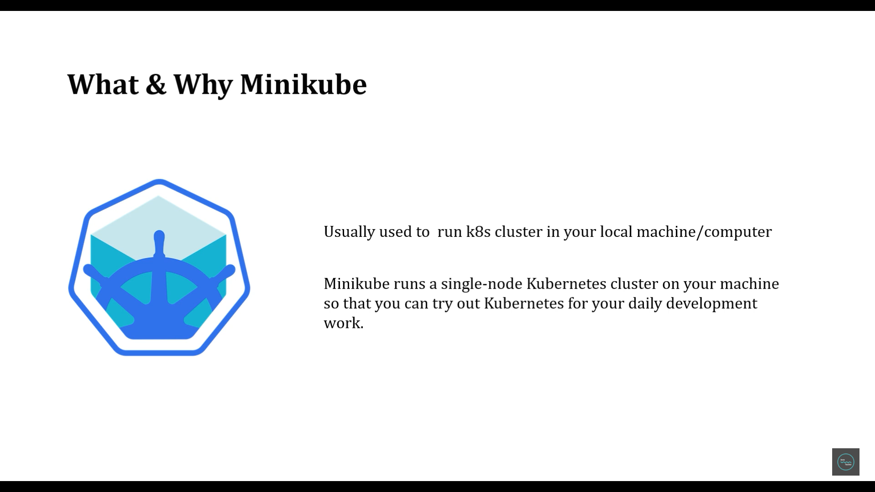

Slide 42
Setup minikube in windows
Install kubectl: https://kubernetes.io/docs/tasks/tools/install-kubectl-windows/
Install Minikube: https://v1-18.docs.kubernetes.io/docs/tasks/tools/install-minikube/
Install Docker Desktop: https://docs.docker.com/desktop/install/windows-install/
Download VirtualBox: https://www.virtualbox.org/wiki/Downloads

Slide 43
Minikube installation

Slide 44
Practical Hands On
9:14 - Verify cluster info
9:31 - verify node
10:10 - Deploy spring boot application to Kubernetes cluster

Slide 45
Part 4 ends here
THANKS FOR ATTENDING THE SESSION

Slide 46
Kubernetes Tutorial | Run & Deploy Spring Boot Application in K8s Cluster using yaml configuration
Part 5 is hands on tutorial

Slide 47
Kubernetes Tutorial | Run & Deploy Spring Boot Application in K8s Cluster using yaml configuration
Part 6 is hands on tutorial

Slide 48
Kubernetes Tutorial | Run & Deploy Spring Boot CRUD Application With MySQL on K8S
Part 7 is hands on tutorial

Slide 49
Kubernetes Tutorial | ConfigMap & Secrets Implementation in Spring Boot CRUD Example
Part 8 is hands on tutorial

Slide 50
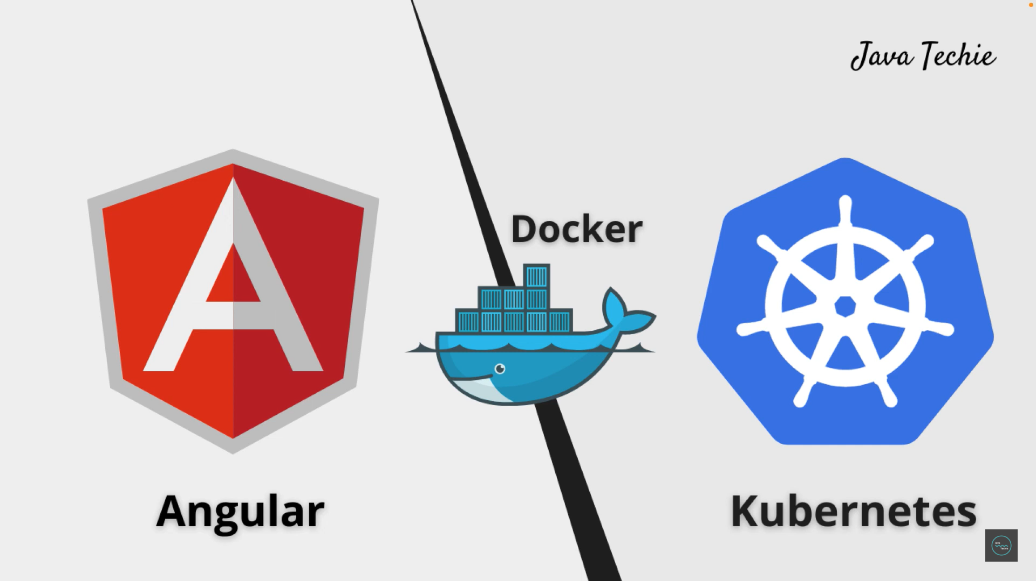


Slide 51
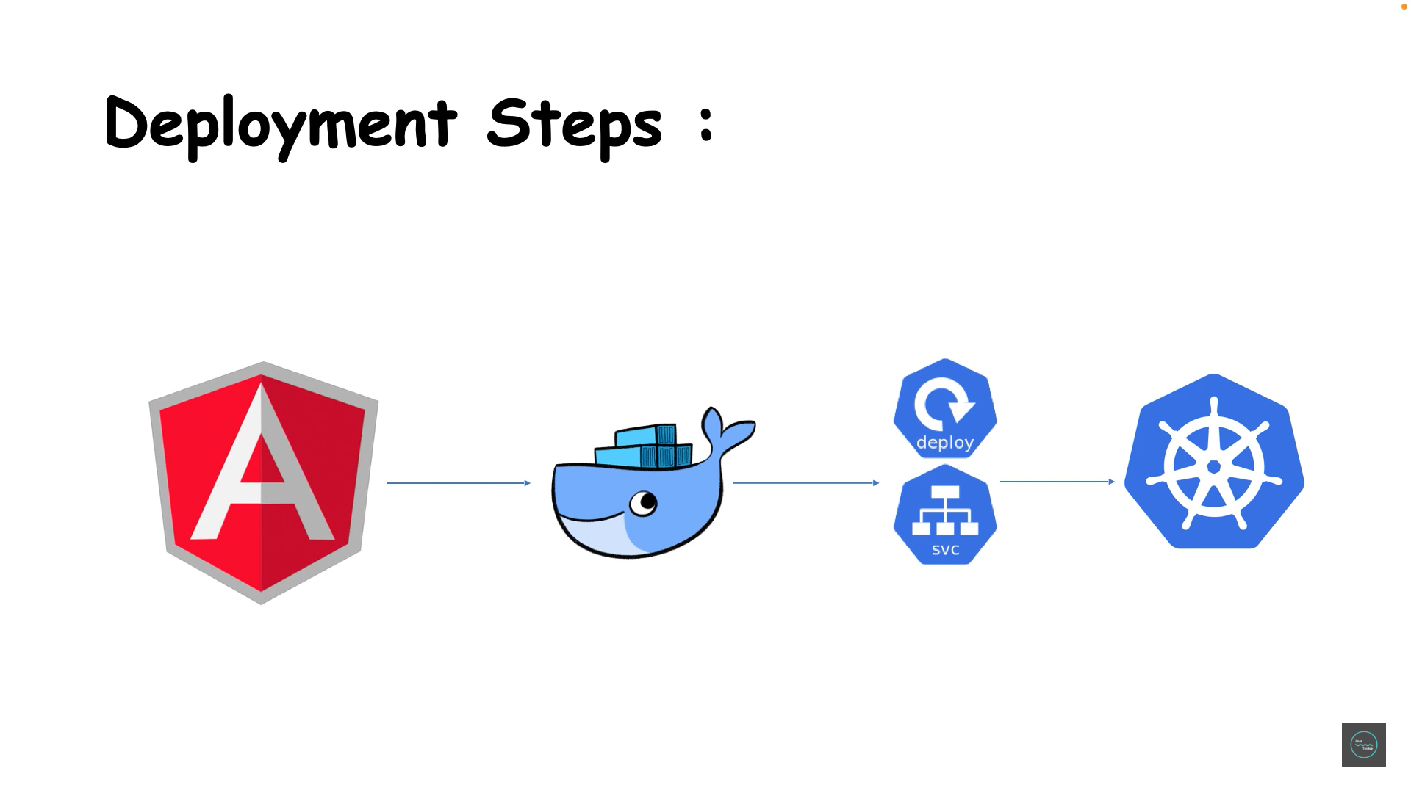

Slide 52
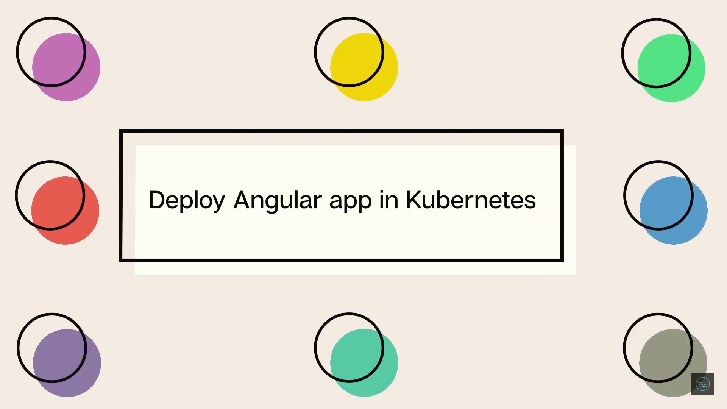


Slide 53
Kubernetes Tutorial | Deploy An Angular Application in K8s Cluster |Step By Step
Rest in Part 9 is hands on tutorial

Slide 54
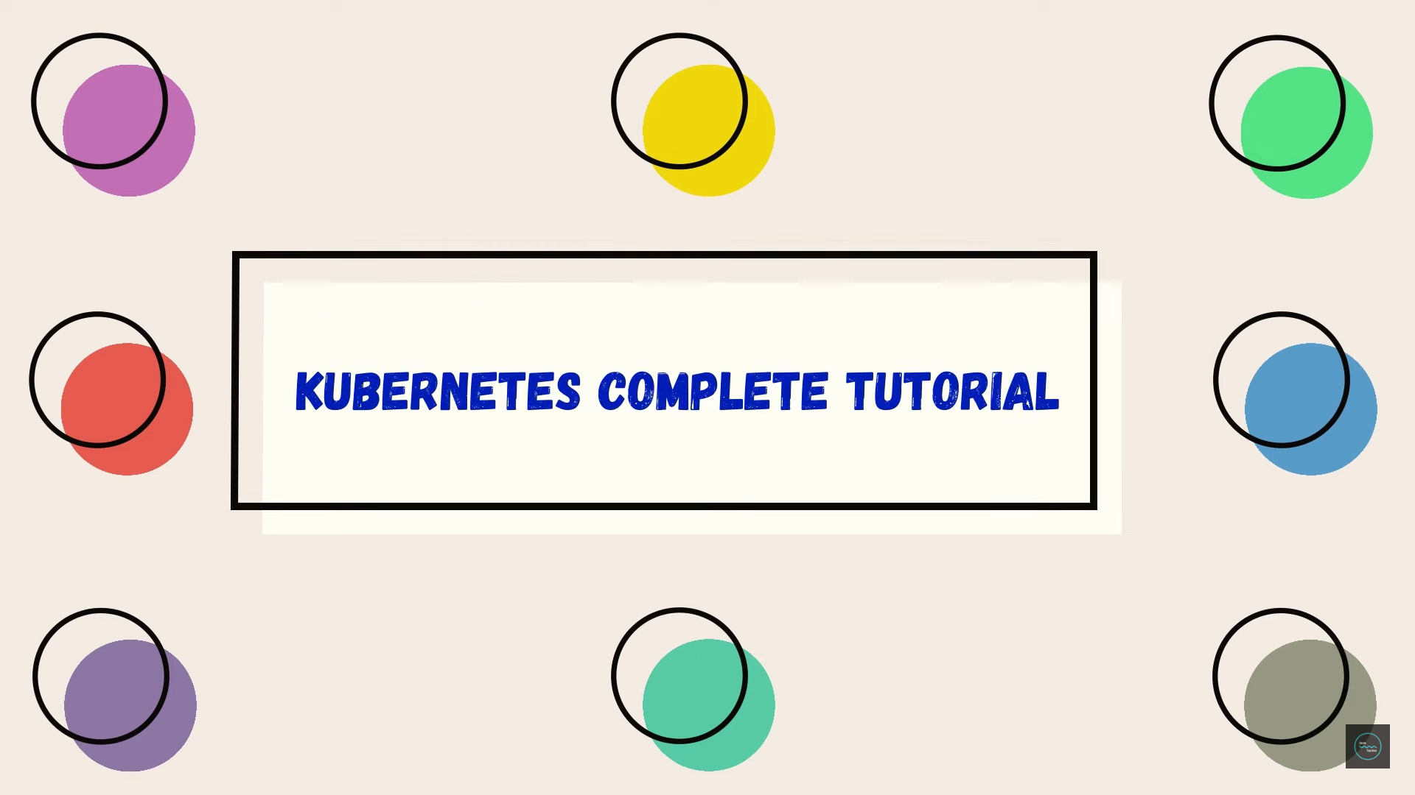

Slide 55
Kubernetes Tutorial for Beginners | 2 Hours Course With Example
Part 10 has revision of Part 1 and rest is hands on tutorial

Slide 56
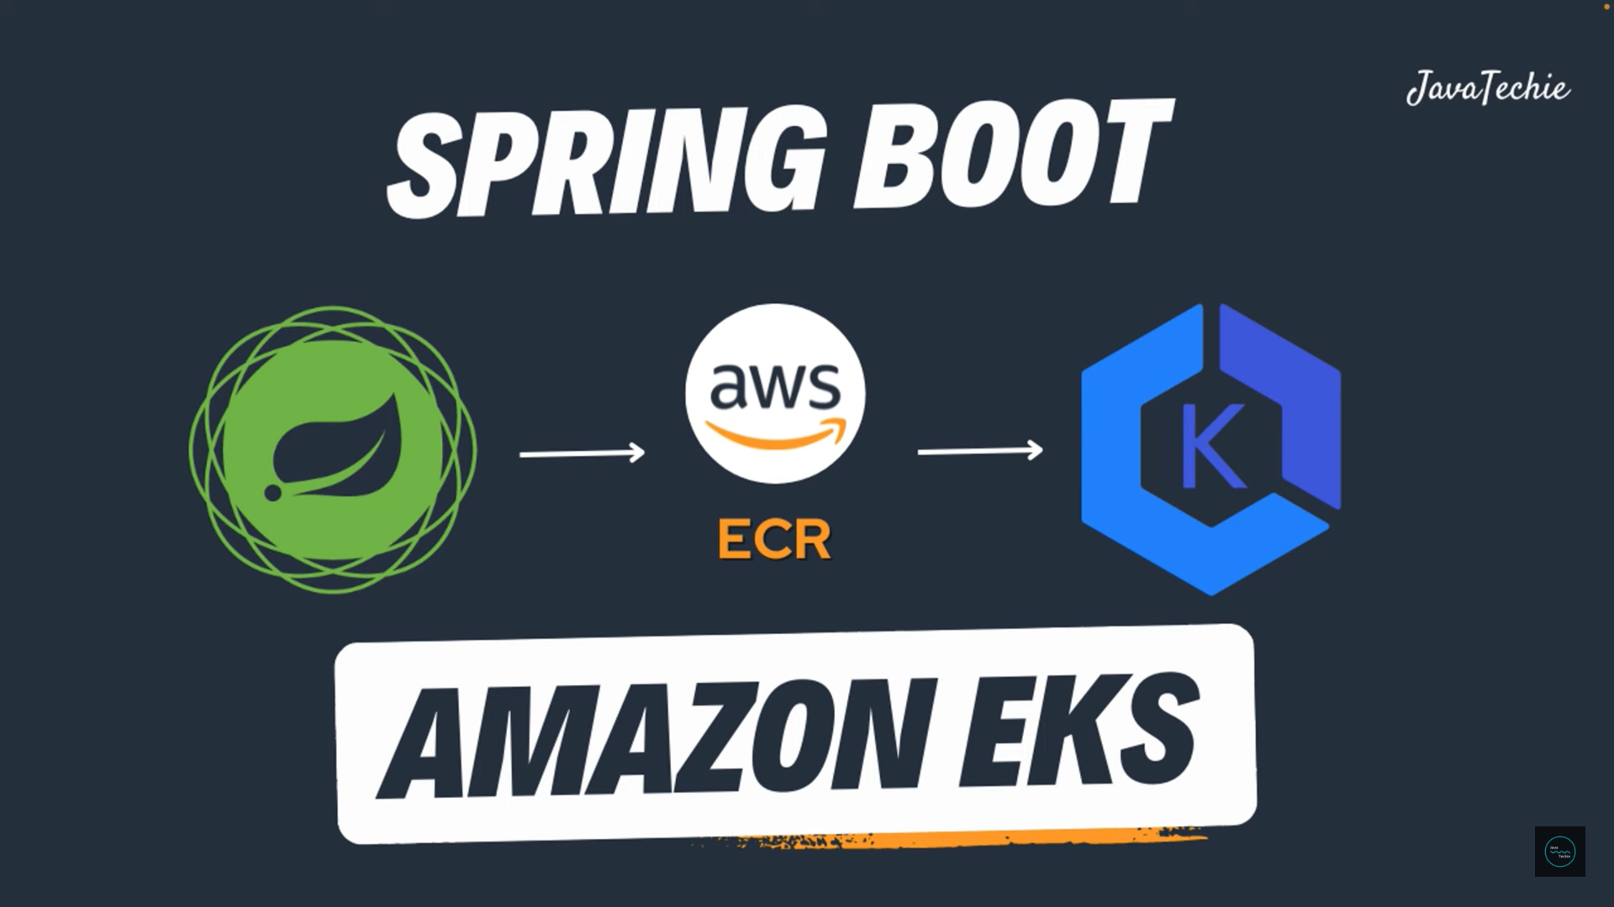


Slide 57
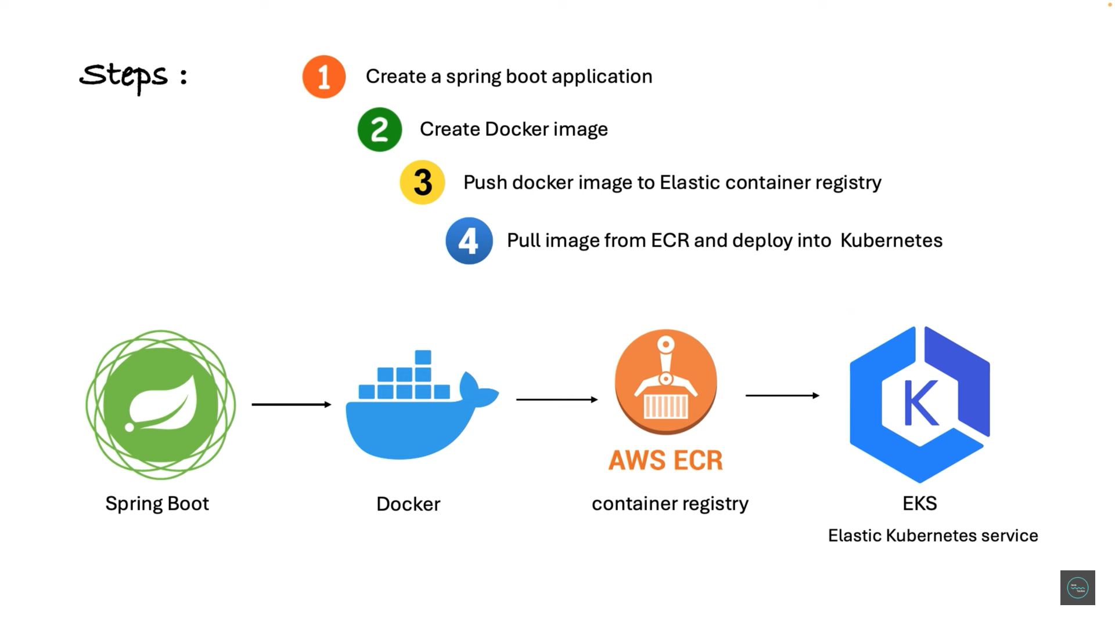


Slide 58
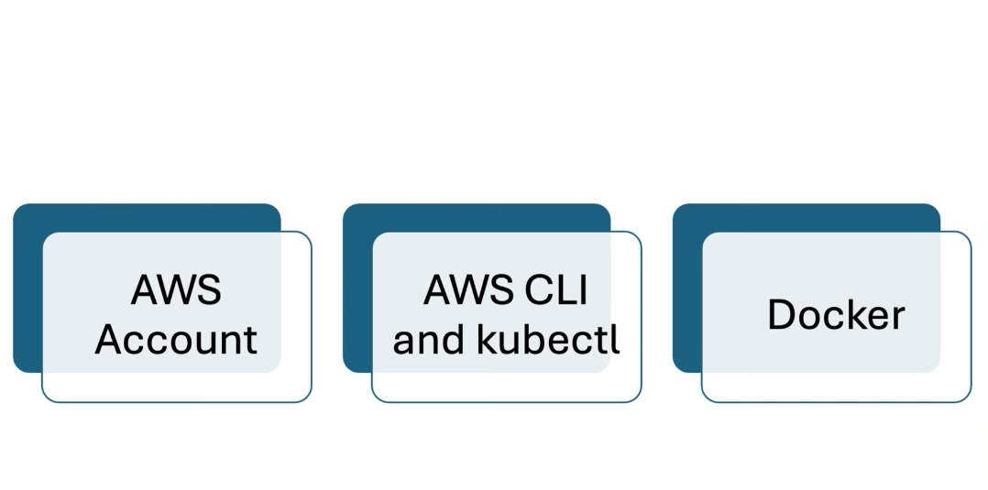

Slide 59
Deploying Spring Boot on AWS EKS (Elastic Kubernetes Service ) Tutorial
Part 11 has 90% hands on tutorial

Slide 60
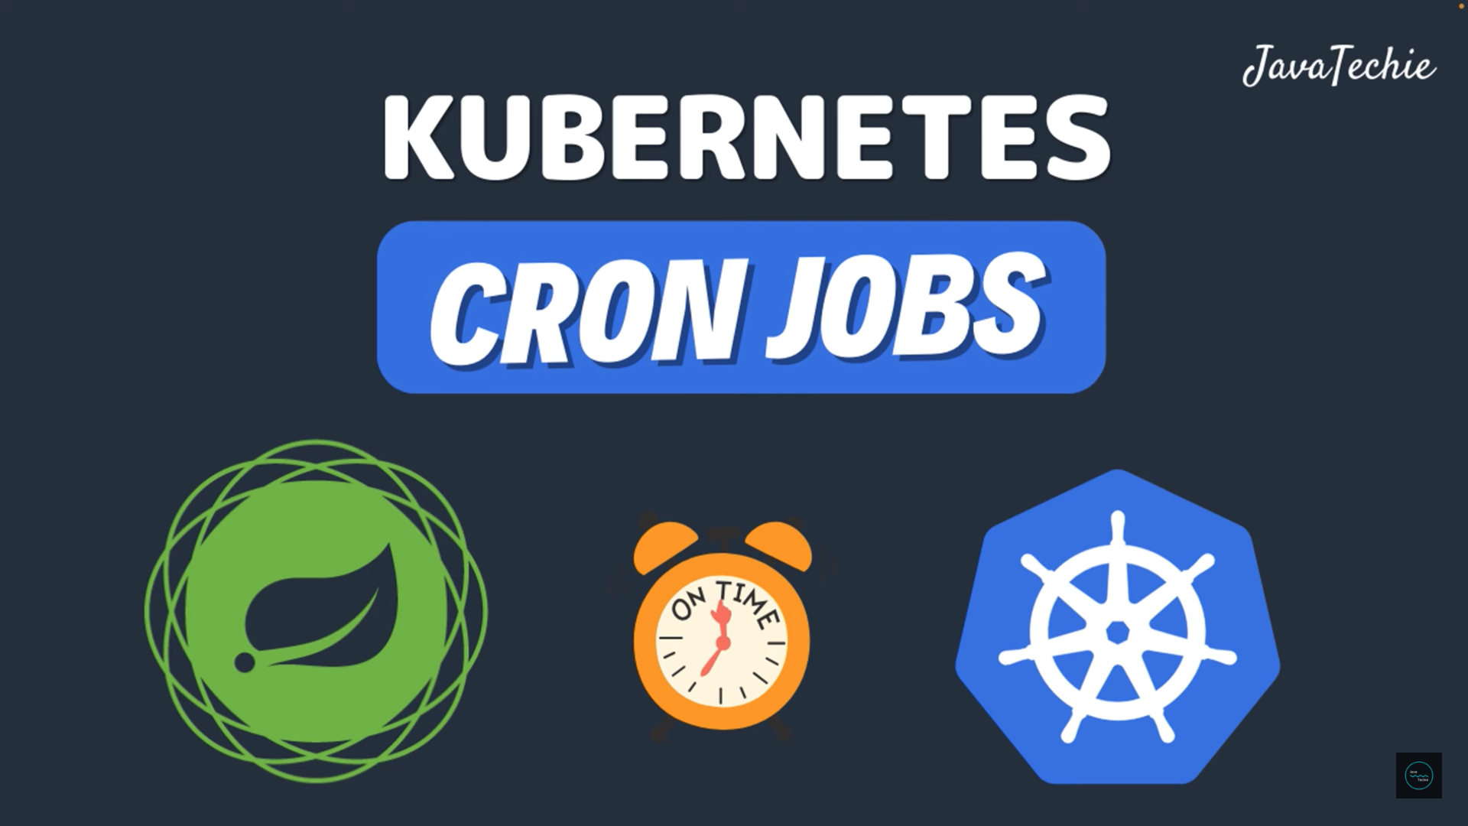


Slide 61
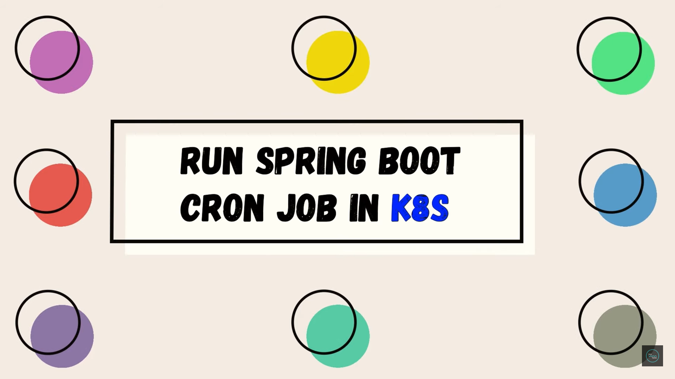


Slide 62
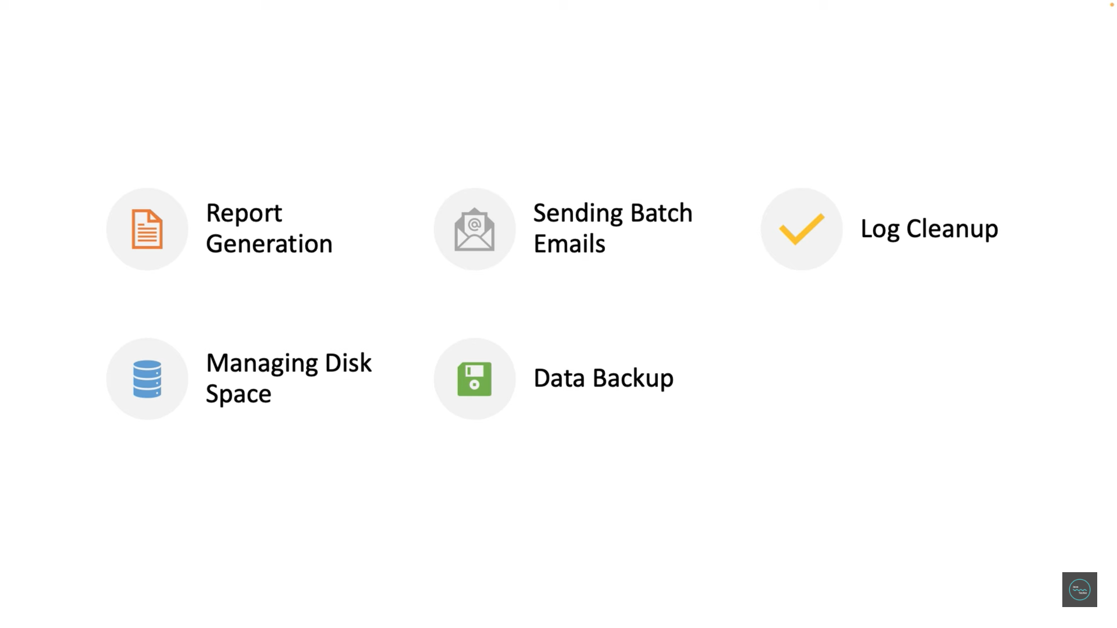


Slide 63
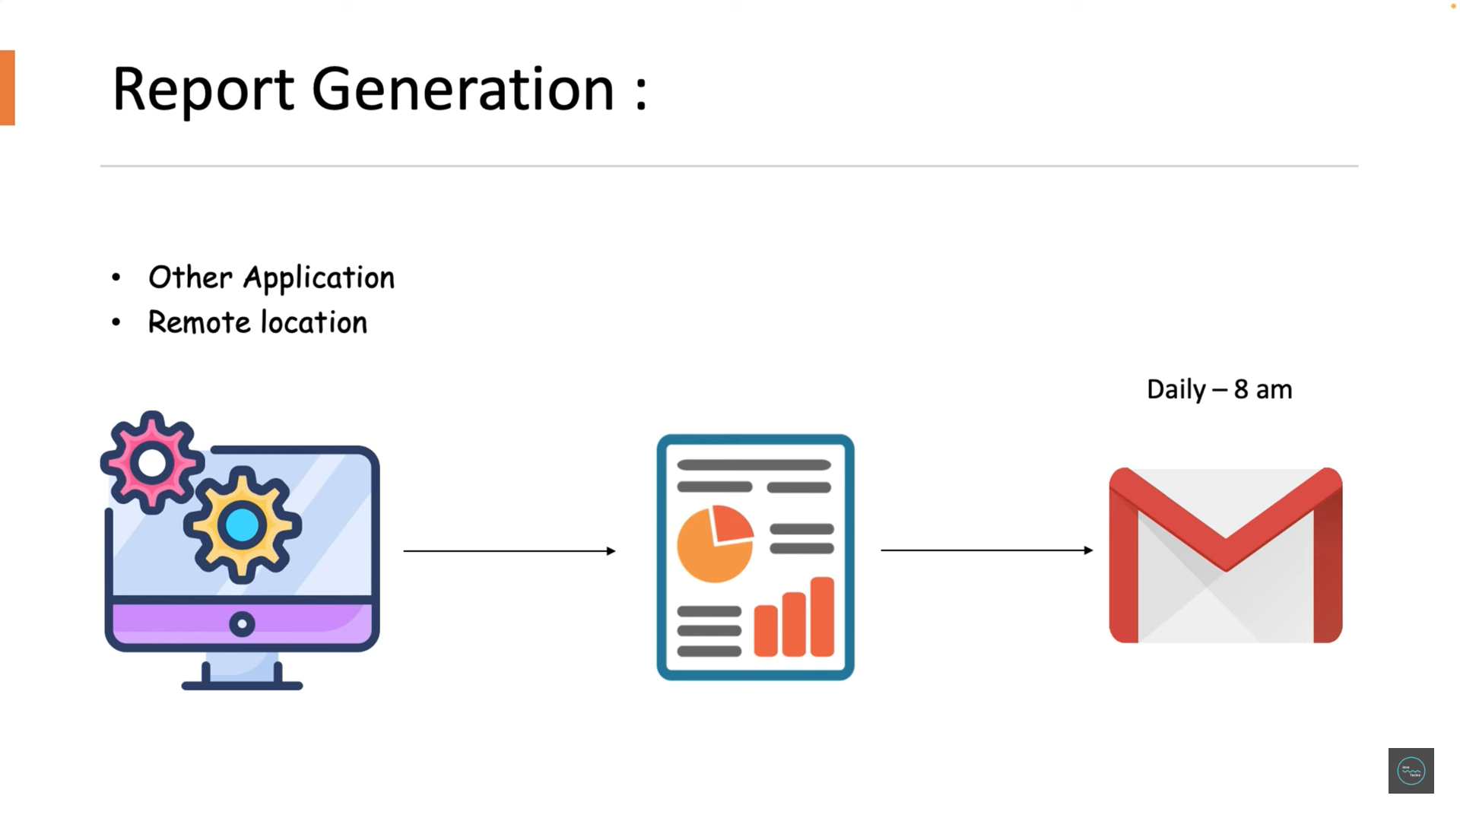

Slide 64
Automate Task Scheduling | Spring Boot Tasks on Kubernetes with Cron Jobs
Part 12 has 90% hands on tutorial

Slide 65
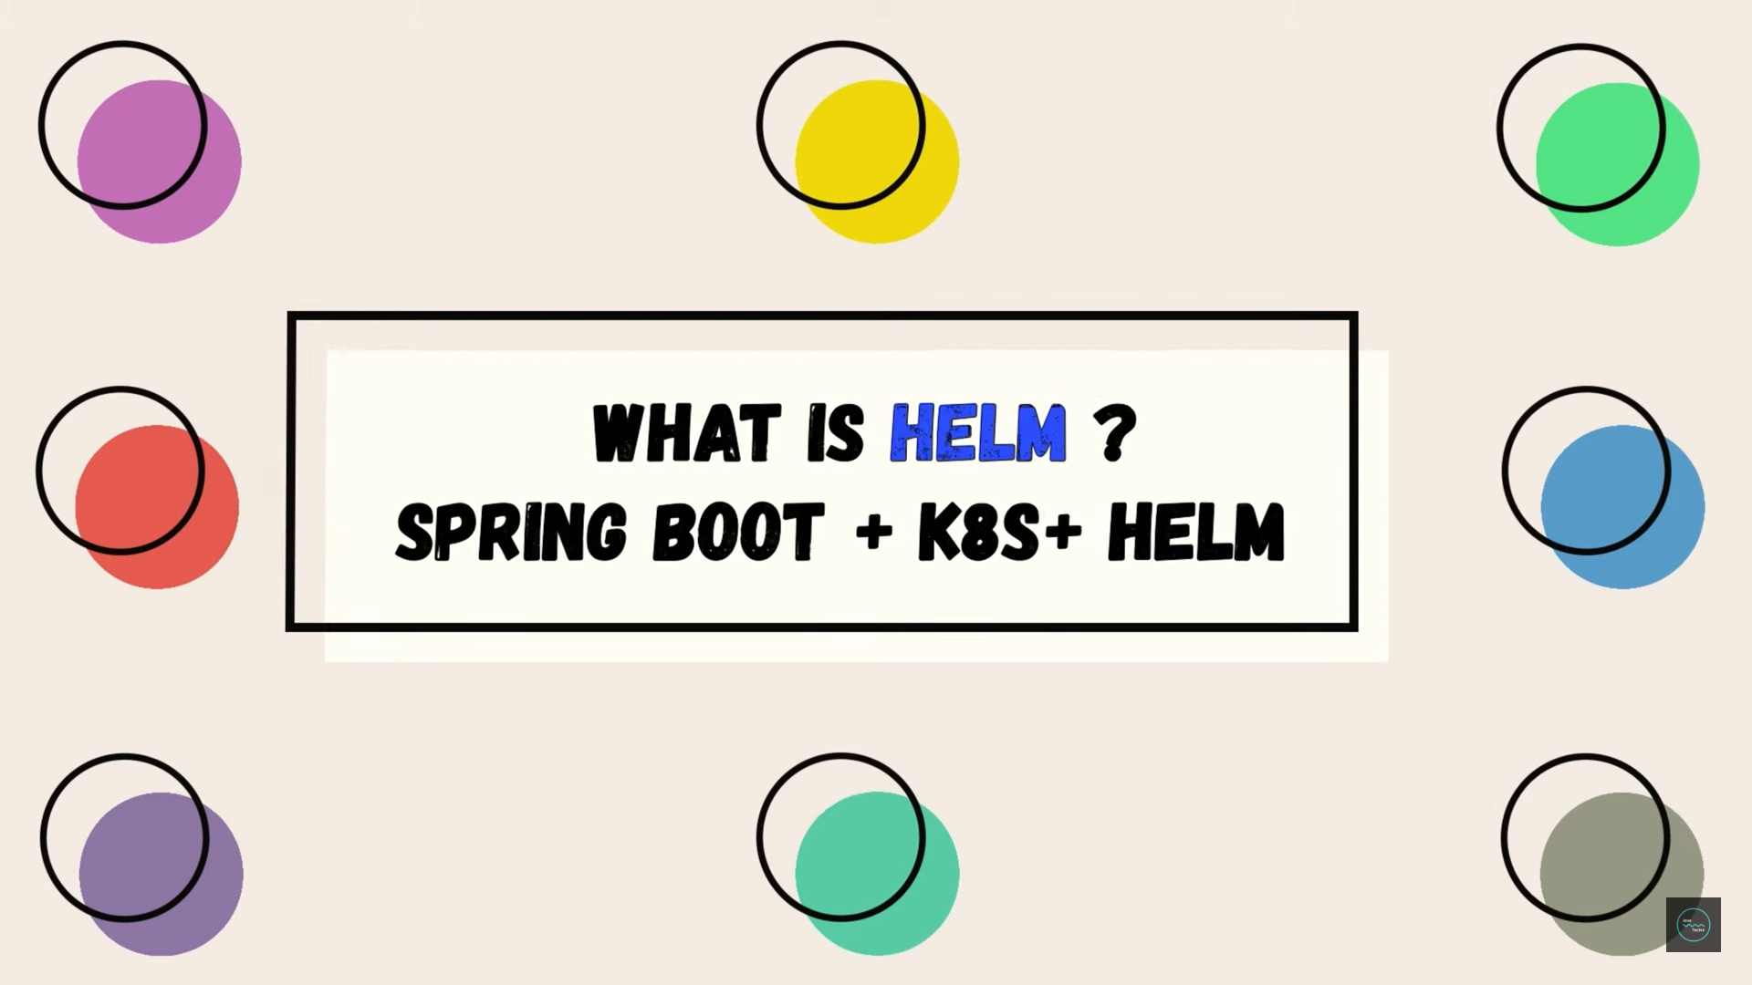


Slide 66


Slide 67


Slide 68


Slide 69


Slide 70


Slide 71


Slide 72


Slide 73


Slide 74


Slide 75


Slide 76


Slide 77


Slide 78
Helm Concepts Explained | Deploy Spring Boot in k8s using Helm-Chart‪
Part 13 has 60% hands on tutorial

Slide 79
Part 13 ends here
THANKS FOR ATTENDING THE SESSION

